Slide 1
Software Testing
Process of validating and verifying the software program/application
OR
Process of finding defects i.e. variance between Expected result and actual result
OR
Process of executing a software program application with intent of finding defects

Slide 2
Why Testing is Necessary
Software Testing is necessary to make sure the product is defect free, and meet as per customer requirements.
Software Testing identifies faults whose removal increases the software quality and increases the software reliability.
it is important as it may cause mission failure,
Impact on operational performance and unreliable if not done properly.

Slide 3
When to start testing
Testing starts right from the requirements phase and continues till release time.
If requirements related defects caught later in the SDLC result in higher cost to fix that defect.

Slide 4
When to stop testing
When Test cases are executed.
When there is project deadlines e.g. release deadlines , testing deadlines.
Test budget has run out.
Coverage of code , functionality or requirements reaches to specific point.

Slide 5
PARTICIPANTS IN TESTING
User
Developer
Tester
Customer

Slide 6
TESTING PRINCIPLES
Testing is context dependent. (Domain )
Exhaustive testing is impossible Testing everything i.e. all combinations of I/P’s & preconditions is impossible. Instead of we use risks & priorities to focus testing efforts.
Early Testing Testing should start early as possible in the software/SDLC & should focus on defined objectives.
Pesticide Paradox if same test cases is repeated over and over again will no longer find any new defects. To overcome this we use pesticide paradox for that test cases needs to be regularly reviewed & revised to potentially find more defects.
Testing shows presence of defects(Testing can show that defects are present but cannot prove that there is no defects.
Absence of error fallacy(finding defect and fixing does not help if system built is unusable, and dos not meet customer requirement)

Slide 7
SDLC stages
Requirement gathering:(business analyst will gather all information from customer & prepare business requirement specification(BRS or URS or SRS) documents.
Analysis: features & functions that need to be put in project are determined or analyzed.
Design: its done by chief Architect. it has 2 types:
A) HLD: Defines overall hierarchy of the function i.e. system architecture & design . gives brief description and functionality of each module.
B)LLD: defines the internal logic of the module/project i.e. actual software components are implemented.

Slide 8
4) Development: based on design document, small modules are summed together and developed.
5)Testing: Testing Phase is done by Testers . here different types of testing are performed.
6)&7) Implementation & Maintenance : Engineers with coordination of developer will install/implement the developed application . The Testing/Maintenance team will suggest to change the software if necessary.

Slide 9
STLC STAGES
It consists of series of activities carried out by Testers methodologically to test your software product.
Requirement Analysis: here tester analysis customer requirements . it is imp. To start testing activities from requirements phase itself because the cost of fixing defect is very less if it is found in requirement phase rather than in future process.
Test Planning: all planning is done here like how testing will be done, what test strategy to be followed, what environment is needed etc.
Test Analysis: after planning analysis phase starts. In this phase we need to dig deeper into the project & figure out what testing needs to be carried out in each SDLC phase . Automation activities are also decided in this field.
Test Design: in this phase WBT & BBT design techniques are used to design Test cases for testing , testers starts writing test cases by following design techniques. Automation scripts also written here in this phase.
Test Construction & Verification: Testers prepare more test cases by keeping negative & positive scenarios in mind. Test Plan document is finalized & verified by reviewers.

Slide 10
Test Execution & Bug Reporting : Test cases are executed and defects are reported in bug tracking tool. Testing is an iterative process. Testing needs to be done after fixing the defect as well.
Final Testing & Implementation : final testing is done for software and non- functional testing are performed in this phase .Final test execution reports and documents are prepared in this phase.
Post Implementation: Review meetings are done in this phase. A document is prepare to cope up similar problems in future process. Document finalized and reviewed.

Slide 11
Types of testing
Functional Testing NonFunctional Testing
Unit Testing Performance Testing
SmokeTesting Volume Testing
User Acceptance Load Testing
Integration Testing Usablity Testing
Regression Testing Stress Testing

Slide 12
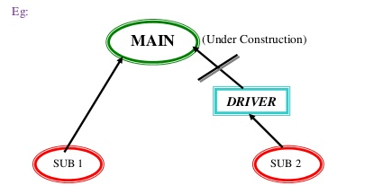
Levels of Testing Unit Testing Integration Testing System Testing Acceptance Testing
1)UNIT TESTING: A smallest testable piece of software. it is procedure used to validate that individual unit of source code is working properly or not?
Tests the functionality of Units. Before entering into unit testing it should be gone through code review.
2)INTEGRATION TESTING: It is a process of combining & testing multiple components/modules together. It starts at module level when various modules are integrated with each other to form a system.
Approaches in incremental integration testing:
1)Bottom up 2)Top down 3)Critical part first4)Hybrid/Sandwich approach
5)Big Bang Approach.
1)Bottom up: Process of testing the very lowest layers of software first is called bottom up approach. Program is tested from bottom to top. In this program programmers use a temperory program(parent) instead of main program , which is under construction. Temperory program is called ”Driver” or “Calling Program”

Slide 13
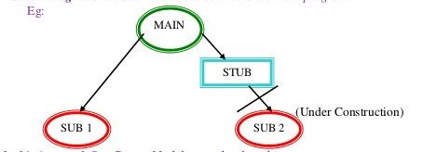
2)Top Down : Process of testing the top most layers of software first is called top-down approach. Programmers use temporary programs called “stubs” instead of sub Programs(child) , which are under construction. other name for stubs is "called programs”. A stub returns the control to the main program.

Slide 14
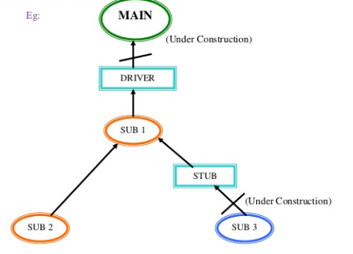
3)HYBRID APPROACH: also known as “sandwich approach”. It is a combination of Top-Down & Bottom-up Approach process. It needs big team. Testing is done simultaneously from both sides.

Slide 15
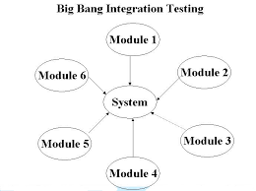
4)BIG BANG APPROACH: It is also known as system approach. It is the simplest integration testing approach:
-All the modules are simply put together and tested.
-this techniques is used only for small projects.
→issues with this approach:
If an error is found it is very difficult to localize that error.
Error may potentially belong to any of the modules being integrated.
Errors might be detected very late in the life-cycle of the project.
Debugging errors found during big bang integration testing are very expensive to fix.
It is a random way of testing.

Slide 16
3)System Testing: system testing is a testing of finally integrated product for compliance against user requirements.
After development of all required modules , development team releases the s/w build to be tested on system testing environment.
4)User Acceptance Testing: Both testers & developers are involved.
After completion of system testing , the UAT to collect feedback from real customer or model customer.
There are 2 ways to conduct UAT:
a)Alpha Testing: its done during pre-release time, done by end user, done in control environment
b)Beta Testing: its done during post-release.its done at customer side. End users are present here. Environment is not under control.

Slide 17
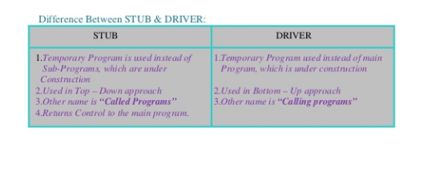

Slide 18
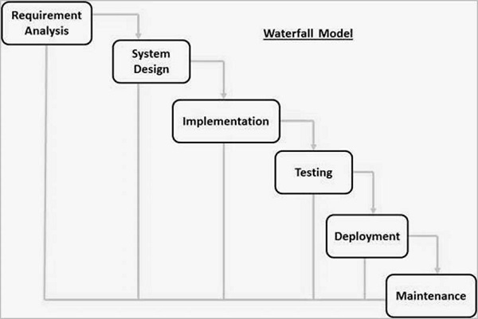
SDLC MODELS
1) WATERFALL MODEL:

Slide 19
Strength & Weaknesses
Easy to understand and simple to use.
Good for management control.
Works well for smaller projects.
Unchangeable requirements.
Linear and sequential model.
Good when clear about requirements.
Cannot backtrack or there is no turning back.
Cannot change requirements later.
Poor model for complex projects.
Deliverables created for each phase are considered frozen.
High amount of risk and uncertainty.

Slide 20
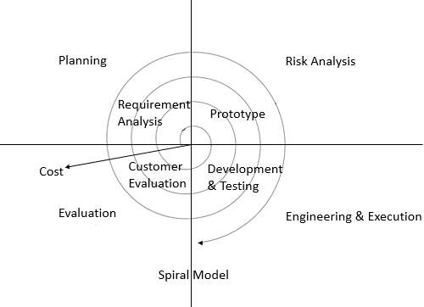
SPIRAL MODEL

Slide 21
Strength & Weakness
called as iterative model.
Requirements can change dynamically.
Used in large , expensive & complicated projects.
Can be costly model to use.
Risk analysis requires highly specific expertise people.
Don’t work well for smaller projects.
High amount of risk analysis.

Slide 22
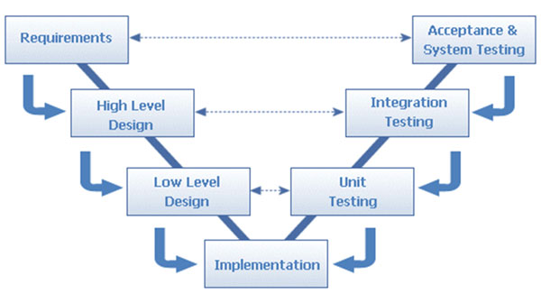
V shape Model or V&V model

Slide 23
Strength & Weakness
Each phase must be completed before the next phase begins.
Development & Testing is done parallelly .
Bring high quality & reliability.
Works well for smaller projects.
Each phase has specific deliverables.
Very rigid like waterfall model.
Does not handle dynamic changes easily.
Does not contain risk analysis activities.

Slide 24
BUILD :
An executable file of application which is released from development team.
An integrated application with all modules released by the development team is called as a build.

Slide 25
Difference between
Verification (QA)
Validation (QC)
Process Oriented.
Done through out life cycle.
Defect detection & correction
Shows defects location as well.
Static testing.
Checking whether we are building right product?
Product Oriented.
Evaluating that the product is meeting the requirements or not?
Helps in identifying presence of defects but not there location.
Dynamic testing.
Have we build the right product?

Slide 26
TYPES/TECHNIQUES OF VERIFICATION
1)Walkthroughs are informal, initiated by the author of the s/w product to a colleague for assistance in locating defects or suggestions for improvements. They are usually unplanned. Author explains the product; colleague comes out with observations and author notes down relevant points and takes corrective actions. .

Slide 27
2)Inspection is a thorough word-by-word checking of a software product with the intention of: - Locating defects - Confirming traceability of relevant requirements - Checking for conformance to relevant standards and conventions Inspections are more formal than walkthroughs. It involves 5 major roles: - Author: person who originally created the work product. - Moderator: Person responsible to ensure the discussions proceed on the productive lines. - Reader: Person responsible for reading all small logical units of the work product - Recorder: Person who records/documents all the defects that arise from the inspection team. - Inspector: All of the inspection team members who analyze and detect the defects within the work product.

Slide 28
3)Review is a subsequent examination of a product for the purpose of monitoring earlier changes. It is a process in which one or more persons check the changed documents or data to determine if the changes are correct. It is also an analysis undertaken at a fixed point in time to determine the degree to which stated objectives have been reached

Slide 29
Functional Testing SMOKE VS SANITY
Its cursory testing
Functional Testing.
Test cases are scripted.
Can be automated.
In-Depth Testing
Subset of Regression Testing.
Test cases are not scripted.
Cannot be automated

Slide 30
NON - FUNCTIONAL TESTING
PERFORMANCE TESTING: measuring/checking the response time of application .it means the speed of processing.
LOAD TESTING: its also called as a scalability testing . Tests performance of application on loading the system with max users at a same time. E.g. : Gmail. Here load /scale means that the number of concurrent users who are operating s/w. execution of our s/w build under customer expected configuration and customers expected load to estimate the performance is LOAD testing.

Slide 31
STRESS TESTING: execution of the software build under customer expected configuration and various load levels to estimate stability or continuity is called stress testing. Checks how the system can behave under extremes such as insufficient memory , inadequate hardware etc
VOLUME TESTING: also known as storage/memory testing. Find weakness in system with respect to its handling of large amounts of data during short time periods. This type of testing ensures that the system will process data across physical & logical boundaries such as across servers & across disk partitions on one server.

Slide 32
SECURITY TESTING: also known as penetration testing. During this testing we validate for:
→Authorization :Access to the valid user and deny to the invalid user
→Access Control: giving access permissions to valid users to use specific services like features or functionalities in s/w
→Encryption & Decryption: Deny to third party access to enter into system . Code conversion is in between client process & server process

Slide 33
GLOBALIZATION TESTING
LOCALIZATION TESTING(L10N):
Process of adapting a globalized application to particular culture/locale.
It is a testing process to validate whether application is capable enough for using in a particular location or country . testing is to carried out to check quality of the product for particular locale or culture.
E.g. zip code for India is in number where as in UK zip code is in alphabets.
INTERNATIONALIZATION TESTING(I18N):
Checks the compatibility of an application to all possible languages.
It is process of designing s/w application so that it can be adapted to various languages & regions without engineering changes.
It is a testing techniques that ensures compatibility of an application to all possible languages.
E.g. amazon.in website for India it shows product price in RS. Where for USA it shows product price in $

Slide 34
Re-TESTING
REGRESSION TESTING
Also called as progression or conformation testing.
Execute the test case for the first time is called progression testing
Re-executing all the failed test cases to check fixing done by development team is really fixed or not ? Is called retesting
Ensuring that the bug is fixed without any side effects is called regression testing.
Re-execution of selected test cases on modified build to estimate completeness and correctness of application without any ripple effects due to bug fixes.

Slide 35
Adhoc testing or informal testing
Every testing team conducts planned testing, but testing team adopts informal testing sometimes due to some challenges or risks.
E.g. lack of time, lack of resources, lack of skills, lack of documentation etc.
There are different ways of Adhoc testing:
1)Monkey testing: due to lack of time, testing team concentrates on some of the main activities in the software build for testing. This style of testing is called as chimpanzee or gorilla testing .

Slide 36
2)Buddy Testing: due to lack of time, the management groups programmers & testers as “buddies”. Every buddy group consists of programmers & testers.
E.g. 1.1 or 2.1 or 3.1
3)Exploratory testing: whenever there is no requirement document or requirements are not clearly understandable or we don’t have time to read requirement documents then engineers explore the application based on there past experience. The style of testing is known as exploratory testing.
Defect Seeding: To estimate the efficiency of test engineers , the programmers add some bugs to the build. this task is known as defect seeding.

Slide 37
SQA :- The monitoring and measuring the strength of development process is called SQA
SQC :- The validation of final product before release to customer is called SQC.

Slide 38
Test Methods or Techniques
Black Box Testing:-
Test cases are based on requirement .No implementation details of the code are considered.
specifications.
Its done by tester. Also called as Behavioral Testing , Functional Testing, Data Driven Testing, I/O driven Testing.
Inputs are given and outputs are compared against specifications.

Slide 39
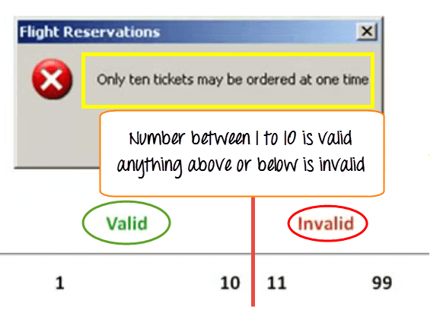
Test Case(Data) Design Techniques
Equivalence class partitioning method (dividing in two part and testing)

Slide 40
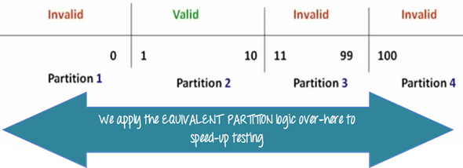

Slide 41
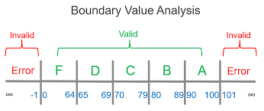
Test Case Design Techniques
2)Boundary Value Analysis(min-1,min, max, max +1)

Slide 42
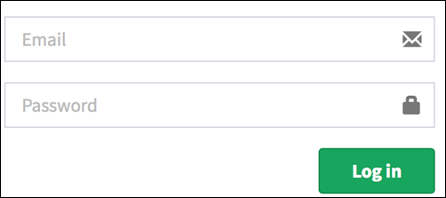
3) Decision Tables(all true false conditions)
Conditions | Rule 1 | Rule 2 | Rule 3 | Rule 4
Username (T/F) | F | T | F | T
Password (T/F) | F | F | T | T
Output (E/H) | E | E | E | H
T – Correct username/password
F – Wrong username/password
E – Error message is displayed
H – Home screen is displayed

Slide 43
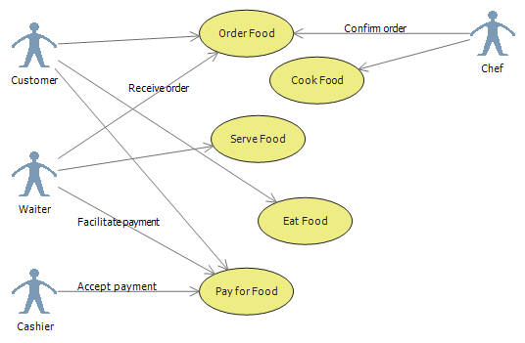
4) Use Case Diagrams(actor, case)

Slide 44
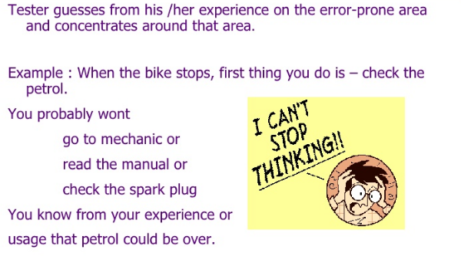
5) Error Guessing (bike e.g.)

Slide 45
White Box Testing :-
Contrary to black box testing.
Testing based on analysis of internal logic (design , code etc).
WBT techniques apply primarily to lower levels of testing.
Mandatory to have a knowledge of code in which the system is designed.

Slide 46
WBT TECHNIQUES
Statement Coverage (execute all statements at least once. Weakest form of coverage as it requires every line of code to be checked)
Decision Coverage or Branch Coverage (Exercise all logical decision on their true or false sides. To test branch we must once check the true condition and once false condition )
Condition Coverage(Executes each decision with all possible outcomes at least once. It requires all cases. Checks each of the ways condition can be made true/false (TT,FF,FT,TF)
Cyclometric Complexity :-
It is imp. For the testers because it provides as indication of the amount of testing.
It is defined as :
V(G)=E-N+2 where ,
N is number of nodes. & E is a number of edges in G. and V(G) is cyclomatric complexity.

Slide 47
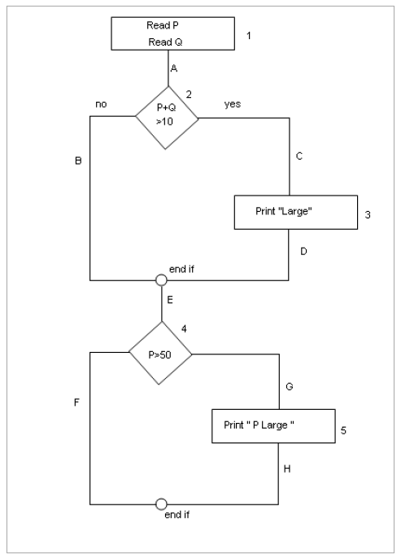
Example:
Read P Read Q IF P+Q > 100 THEN Print “Large” ENDIF If P > 50 THEN Print “P Large” ENDIF
V(G)=E-N+2
=8-5+2
=1

Slide 48
To calculate Statement Coverage, find out the shortest number of paths following which all the nodes will be covered. Here by traversing through path 1A-2C-3D-E-4G-5H all the nodes are covered. So Statement Coverage is 1.
To calculate Branch Coverage, find out the minimum number of paths which will ensure covering of all the edges. 1A-2C-3D-E-4G-5H, and 1A-2B-E-4F
Hence Branch Coverage is 2.
Path Coverage ensures covering of all the paths from start to end. All possible paths are-
1A-2B-E-4F 1A-2B-E-4G-5H 1A-2C-3D-E-4G-5H 1A-2C-3D-E-4F
So path coverage is 4.
Thus for the above example SC=1, BC=2 and PC=4.

Slide 49
TEST PLAN
Test Plan acts as anchor for the execution , tracking & reporting of the entire testing project and covers:
What needs to be tested.
How the testing is going to perform.
How the tests are conducted.
Who does testing?
What resources are needed for testing.
The time line by which the testing activities will be performed.

Slide 50
TEST PLAN TEMPLATE
Test Plan Identifier(document have unique id)
Introduction(state purpose of plan , specify goals & objectives)
Test Items(A list of what is to be tested)
Features to be tested(QA manager decides what to be tested from user’s view)
Features not to be tested(what is not to be tested from users point of view . here we need to identify and justify why features is not to be tested.)

Slide 51
Approach (mentions overall test strategies/methods for your test plan e.g. manual testing , automation testing ,WBT ,BBT etc )
Item Pass/Fail Criteria (specify criteria that will be used to determine whether each test item(software/application)has passed or failed testing) . Criteria can be show stopper issues , how significant the problem is? Does it affect any critical function
Suspension & Resumption criteria (suspension criteria specify the criteria to be used to suspend all or portion of testing activities while resumption criteria specify when testing can resume after its being suspended. E.g. printer or network

Slide 52
Test Deliverables(are nothing but all types of documents which are used in implementing the testing it starts with Sign In to Signoff. Types are test reports ,Test summary reports ,bug report etc.)
Environmental Needs(specifies about hardware /software/network etc)
Responsibilities(list responsibility of each team/role/individual)
Staffing & Training needs(how many staff members are required, what kind of skills are required, what kind of training will be required.

Slide 53
Schedule (when will life cycle end, when will testing start, what will b the target/milestones pertaining to time)
Risks & Contingencies(what are the contingencies(an unforeseen event )in case of risk manifests itself. What are the mitigation plans i.e. alternate plans for the risk)
Approvals(specify all names & roles of persons who must approve the plan. Provides space for signatures and dates if the document is to be printed)

Slide 54
TEST CASES
A case that tests the functionality of specific object.
It is a description of what to be tested, what data to be given & what actions to be done to check the actual result against the expected result.
It is a document which includes step description of i/p, o/p conditions with test data along with expected results.

Slide 55
Characteristics of Good Test Cases
Test case should start with what you’re testing .
TC should be independent.
TC should not contain “if statements”.
TC should be uniform.
Good test cases should find faults, should represents others, easy to maintain and cheap to use.
Issues to be considered: TC should be traceable, no duplicate test cases, out dated test cases should be cleared off, all test cases should be executable.

Slide 56
Structure of Test Cases/ Template of Test Cases
TC Id | TC NAME | OBJECTIVE /DESCRIPTION | Precondition | Steps To Be Followed | TEST DATA | Expected Result | Actual Result | STATUS
TC_1 | Login (ok Button) | To check whether user can login successfully | User should be logged in | 1.Enter valid username 2.Enter valid password 3.Click OK button | UN: Me PWD: tips | Should login successfully | Same as ER | Pass

Slide 57
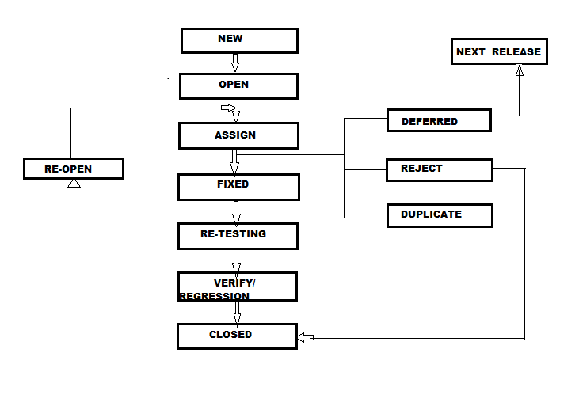
DEFECT LIFE CYCLE

Slide 58
New : Tester found new bug & report it to Test Lead(TL)
Open : TL open this bug & assign to Developer
Assign: Developer has 3 choices after assigning the bug:
Reject: if its hardware related issue its not a bug.
Deferred: he can postpone bug fixing according to priority of bug.
Duplicate: if bug is repeated twice or two bugs mention same concept of bug, then one bug is mentioned as duplicate.

Slide 59
Fixed: If there is not such conditions such as reject, duplicate the developer has to fix the defect.
Re-Testing: Re-Test the whole application to find the defects if the defect is still there. In case there is a bug present, they will re-open the bug & if bug not there they will move to verify.
Re-Open: if bug raised during re-testing we re-open bug.
Verify: Test Whole Application(i.e. Regression Testing)
Close: Close the Application or bug.

Slide 60
DEFECT : missing, wrong, not expected in the software which is difficult to understand , hard to use is called as DEFECT.
Defect Age : Time gap b/w defect reporting & defect closing or deferring.
Defect Density: The Average no. of defects found in module or function is called defect density.
Types Of Defects:
UI Defects : alignment or spelling mistake
Error Handling Defects : error msg not coming for wrong operation , correct error msg but incomplete.
Input Domain Defects : Does not take valid i/p, Taking valid & Invalid also ,or taking valid type but range exceeded.

Slide 61
Race Conditions Defect: Hang or Dead Lock
H/W related defects: Device is not connecting, device connected but giving wrong o/p’s
Load Conditions Defects: does not allow customer Expected load.
Source Defects: Wrong help document or Incomplete help document.
ID Control Defects: Logo missing, wrong logo, team members name missing etc.

Slide 62
Severity & Priority
Severity :The degree of impact casted by the bug on an application. or Severity is the seriousness of the problem.
Priority : Relative degree of precedence given to a bug for its fixation. Or it is a urgency of fixing the problem.

Slide 63
Types of Severity
Critical: The defect that results in the termination of the complete system or one or more component of the system and causes extensive corruption of the data. The failed function is unusable and there is no acceptable alternative method to achieve the required results then the severity will be stated as critical.
Major: The defect that results in the termination of the complete system or one or more component of the system and causes extensive corruption of the data. The failed function is unusable but there exists an acceptable alternative method to achieve the required results then the severity will be stated as major.
Moderate: The defect that does not result in the termination, but causes the system to produce incorrect, incomplete or inconsistent results then the severity will be stated as moderate.
Minor: The defect that does not result in the termination and does not damage the usability of the system and the desired results can be easily obtained by working around the defects then the severity is stated as minor.

Slide 64
Types of Priority
Low: The defect is an irritant which should be repaired, but repair can be deferred until after more serious defect have been fixed.
Medium: The defect should be resolved in the normal course of development activities. It can wait until a new build or version is created.
High: The defect must be resolved as soon as possible because the defect is affecting the application or the product severely. The system cannot be used until the repair has been done.

Slide 65
E.g. of Severity & Priority
High Priority & High Severity: An error which occurs on the basic functionality of the application and will not allow the user to use the system. (Eg. A site maintaining the student details, on saving record if it, doesn’t allow to save the record then this is high priority and high severity bug.)
High Priority & Low Severity: The spelling mistakes that happens on the cover page or heading or title of an application.
High Severity & Low Priority: An error which occurs on the functionality of the application (for which there is no workaround) and will not allow the user to use the system but on click of link which is rarely used by the end user.
Low Priority and Low Severity: Any cosmetic or spelling issues which is within a paragraph or in the report (Not on cover page, heading, title).

Slide 66
Defect Report Template
Defect Id/ | TC ID | Origin | DESCRIPTION | Severity | Priority | STATUS
DI_001 | TC_025 | Login_OK | User Login for invalid Email Id And invalid Password | Critical/Major/ Moderate/Minor | High/Medium/Low | Fixed/Reject/Duplicate/ Defer

